Slide 1


MoveMark
Adhithyan vp Backend & AI Dev
Sreesh K Suresh
Frontend dev

Slide 2
A Small Story

Slide 3
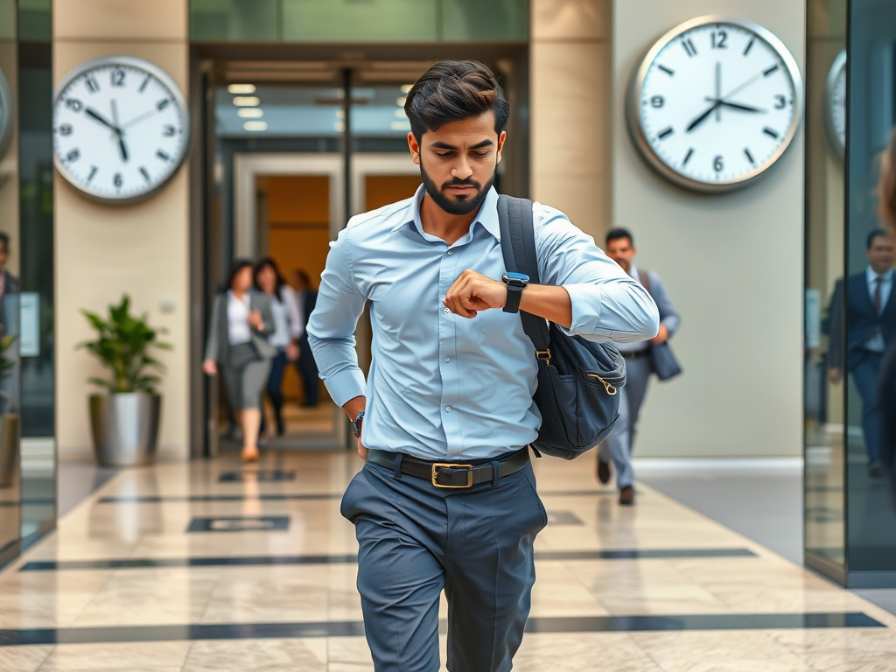
Running Late

Slide 4
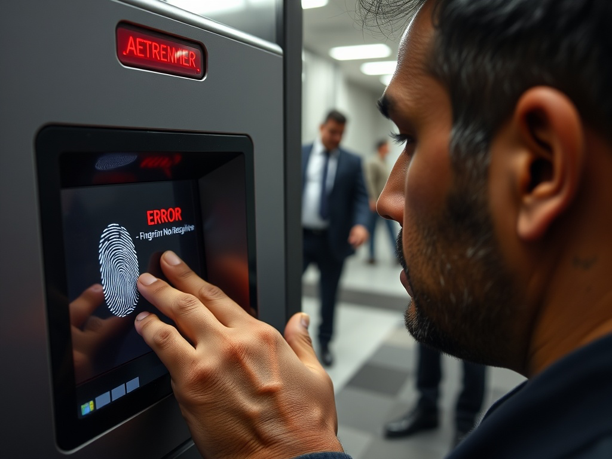
Sweaty Hands, Slipping Fingerprint ID

Slide 5
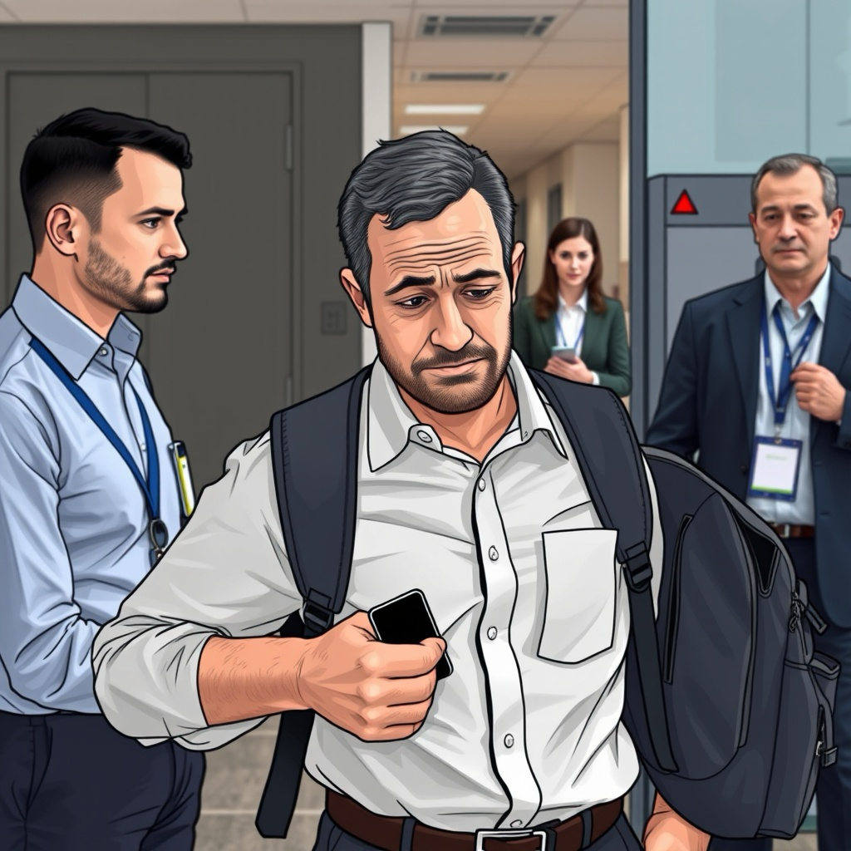
Forgot ID Card Too!

Slide 6

Late Marked, Frustrated

Slide 7
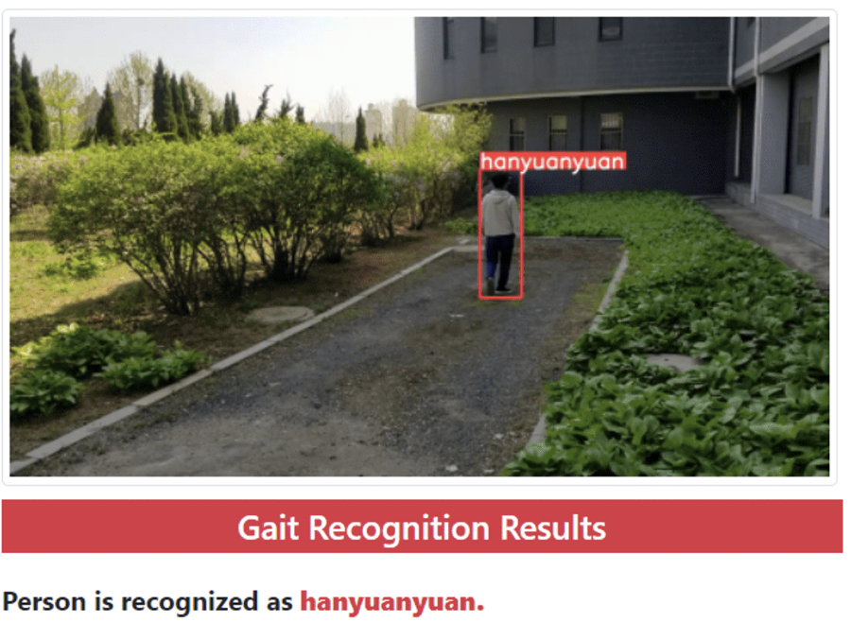
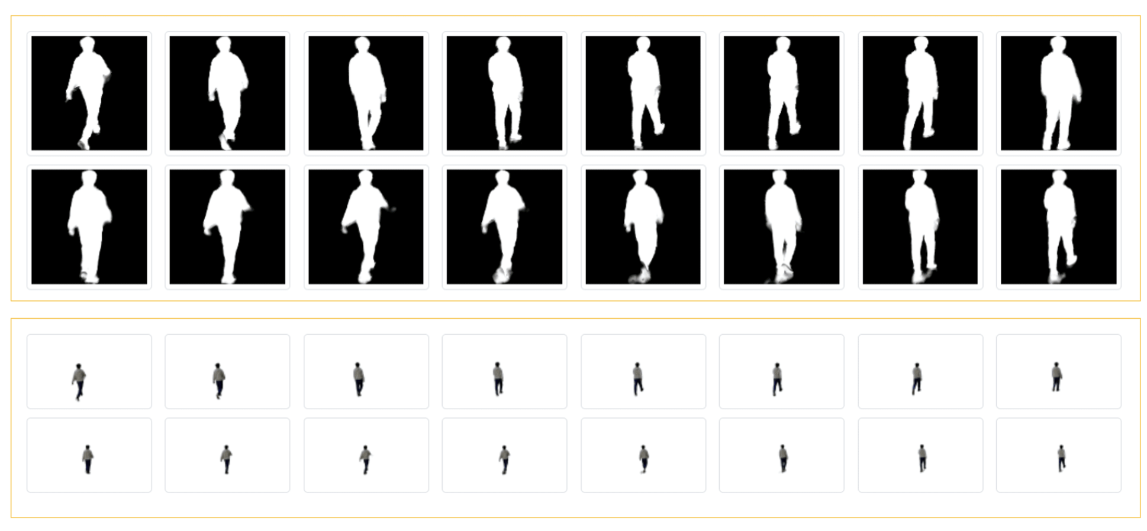
Our Solution Gait Recognition Research paper references in final slide

Slide 8
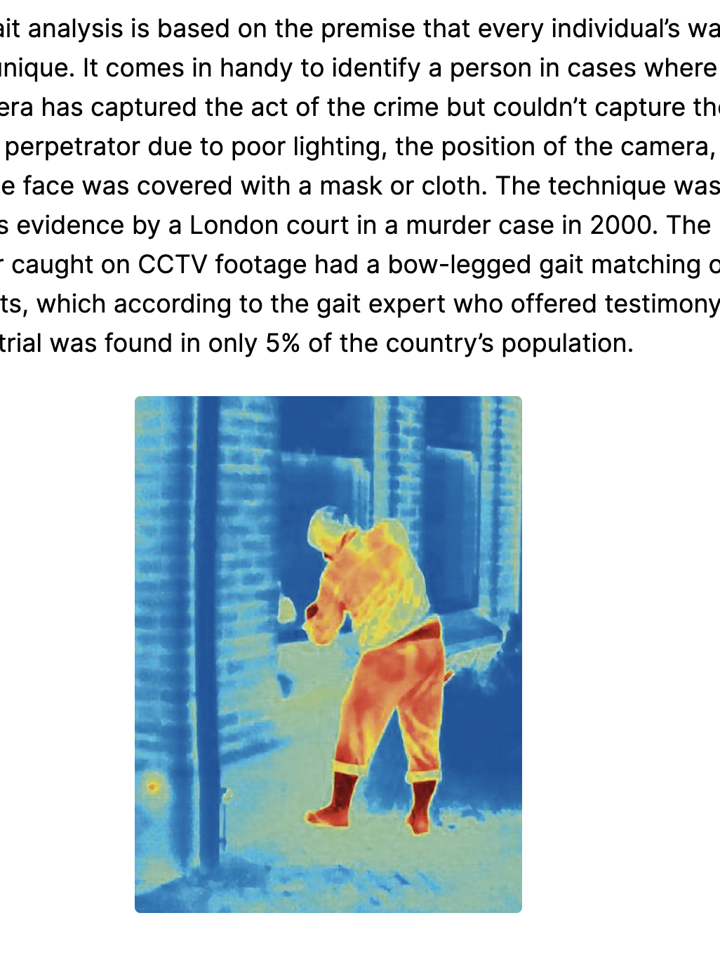
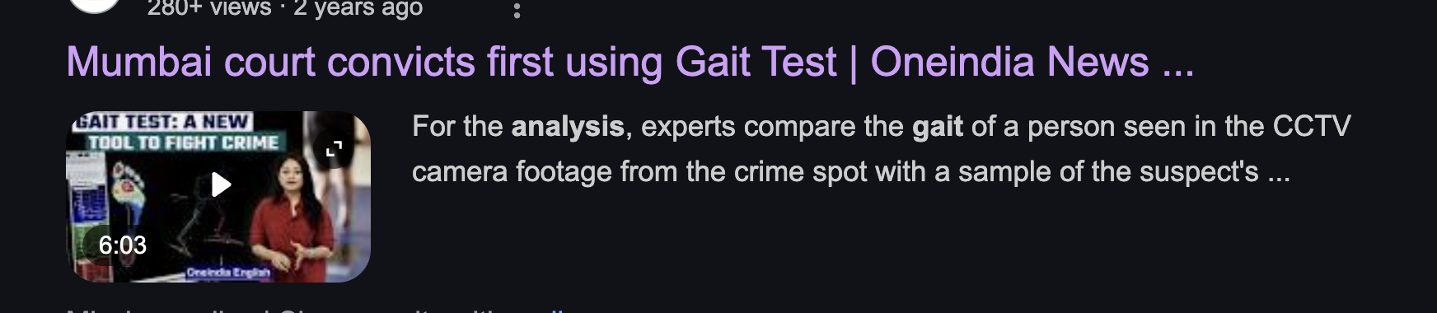
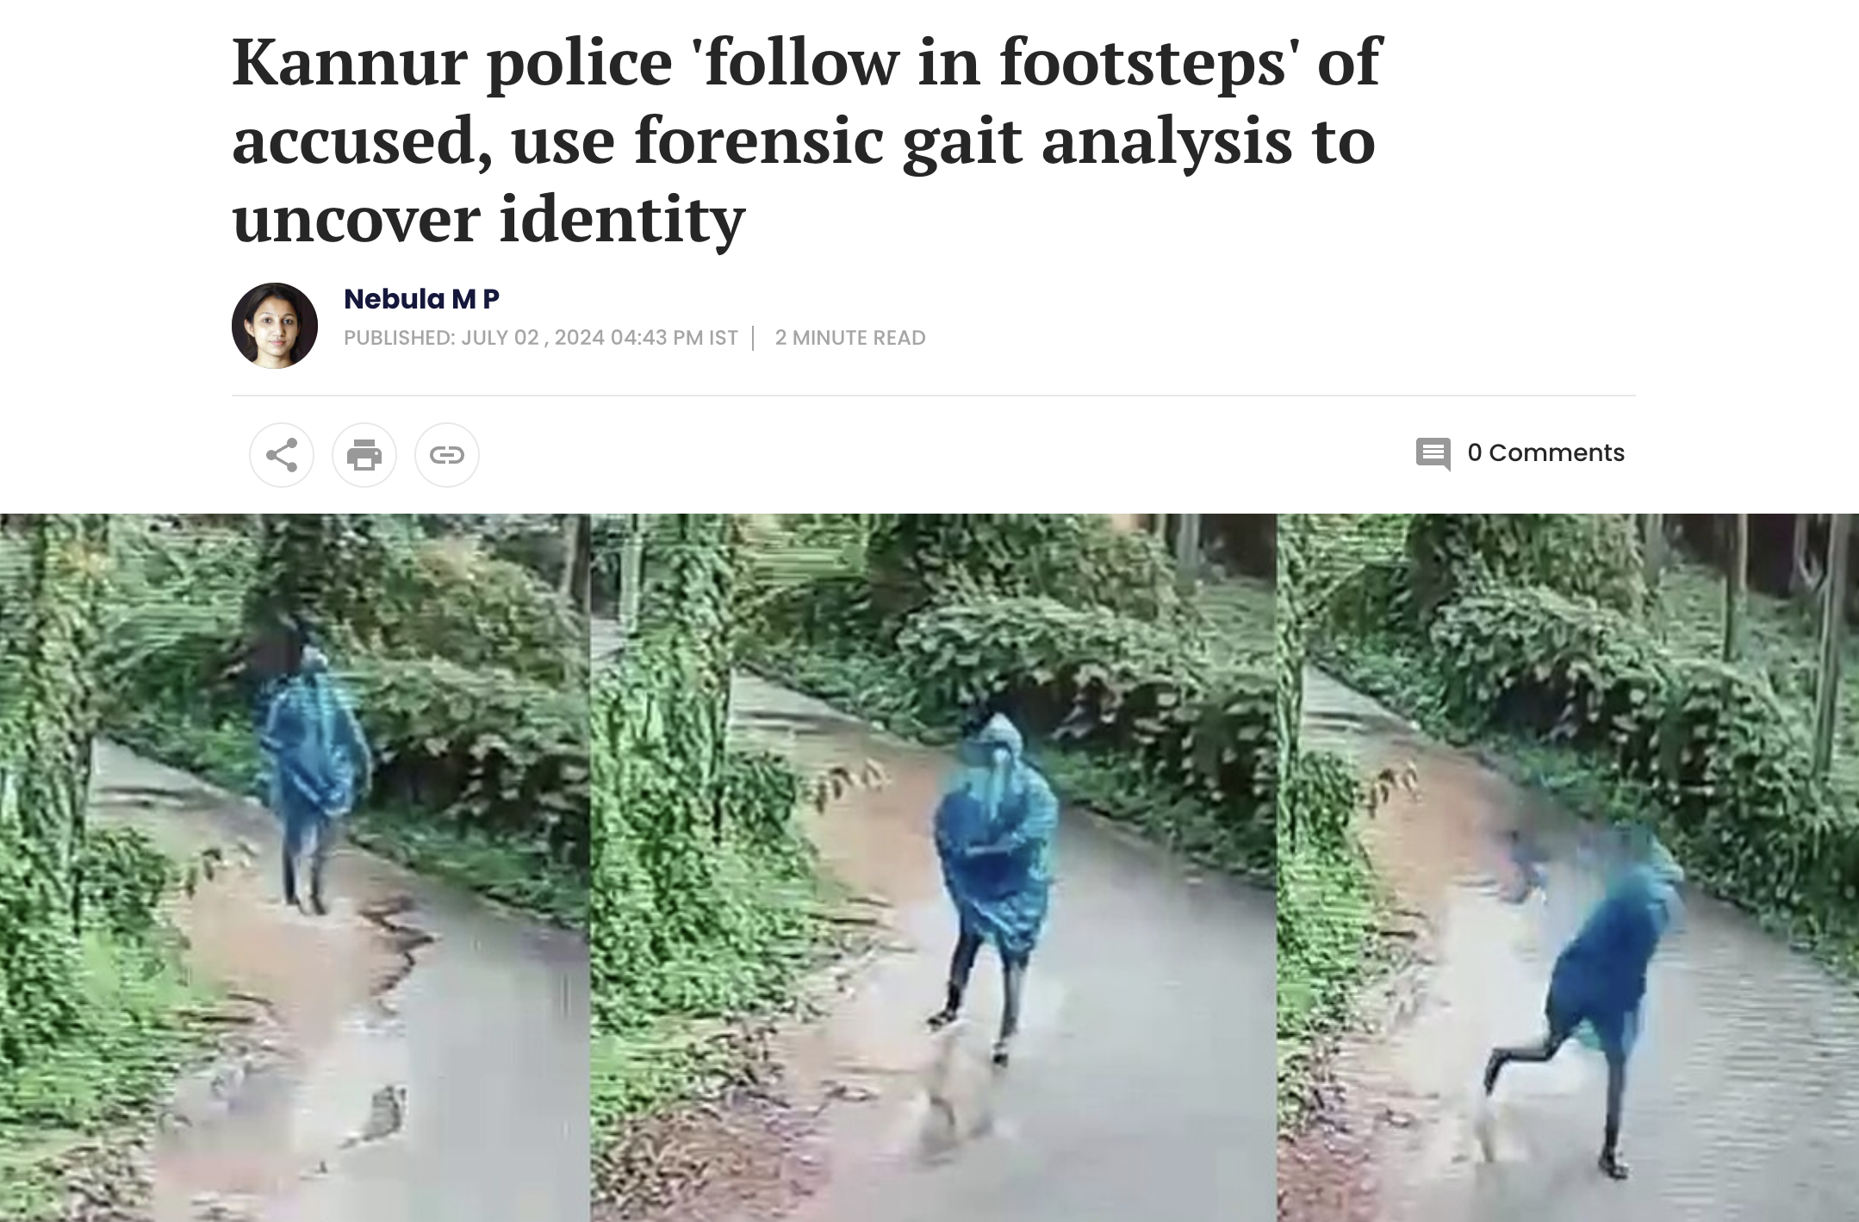
Gait Recognition Police cases

Slide 9
Gait Recognition
First register your video of walking for testing 8 seconds (not the final number)
Next time you come in the camera you will be recognized.
Check in and check out time will be marked.
Employee can check their phone for confirmation

Slide 10

Tech stack
HR app admin (windows and web app , Flutter)
Employee (User app in android , Flutter)
Backend (Fastapi)
Database(Sql)

Slide 11
Features
Gait Recognition
Advanced analytics
Employees list
Anomaly detection (Isolation Forest)
Leave Request Management
Attendance app for Employee

Slide 12
Demo video Admin app

Slide 13
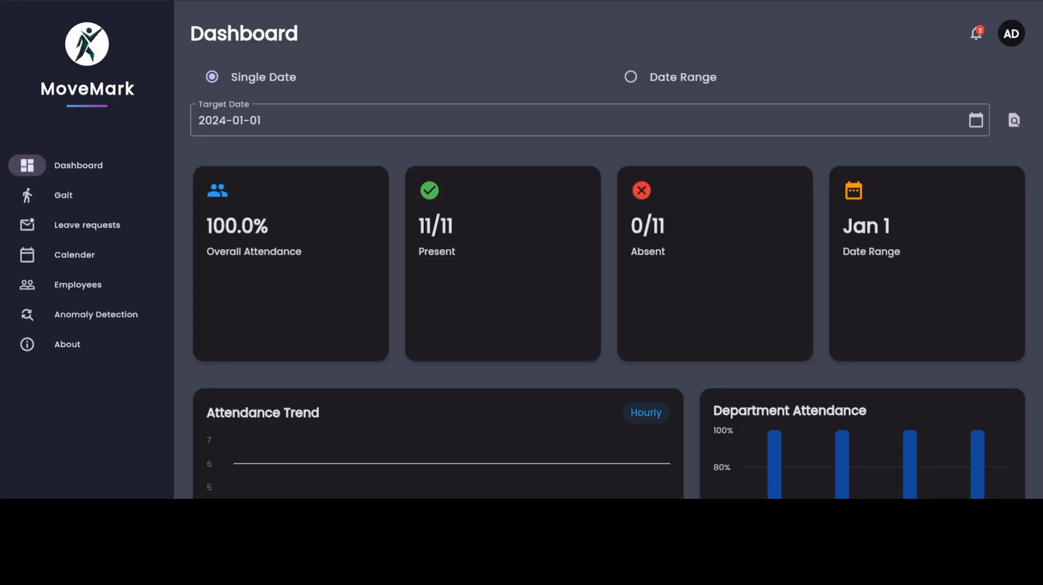

Slide 14
Demo video Mobile app

Slide 15
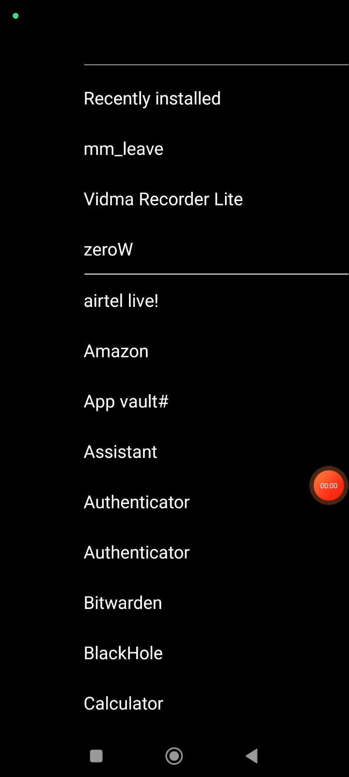

Slide 16
References
GaitPretreatment: Robust Pretreatment Strategy for Gait Recognition(Han, Yuanyuan and Wang, Zhong and Han, Xin and Fan, Xiaoya)
Gait Recognition Based on Deep Learning: A Survey (Claudio Filipi Gonçalves dos Santos, Diego de Souza Oliveira, Leandro A. Passos, Rafael Gonçalves Pires, Daniel Felipe Silva Santos, Lucas Pascotti Valem, Thierry P. Moreira, Marcos Cleison S. Santana, Mateus Roder, João Paulo Papa, Danilo Colombo)
Python
Fastapi
Flask
Tensorflow
Flutter

Slide 17
Thank you

